Slide 1
Why use Multimedia in Education?

Slide 2
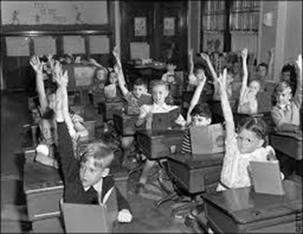
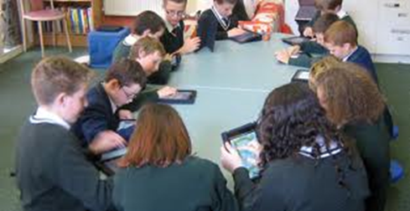
BEFORE TODAY

Slide 3
Why use Multimedia in Education?
Definition:
“Multimedia is the exciting combination of computer hardware and software that allows you to integrate video, animation, audio, graphics, and test resources to develop effective presentations on an affordable desktop computer ” (Fenrich, 1997)
The tools:
Text
Video
Sound
Graphics
Animation
Notes:
What is Multimedia

Slide 4
https://youtu.be/kMi13DoDBAM

Slide 5
Multimedia has a key role to play in our teaching resources.
Effectiveness and senses
Appeal, Fascination
Interactive learning
Personal development
Academic performance
Means of “drill and practice”
Notes:
Point 2 : Capture attention

Slide 6
What are the benefits?
Pedagogical Strength

Slide 7
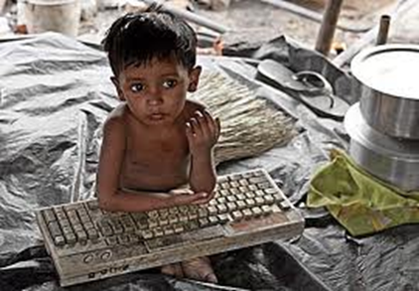
What are the benefits?

Slide 8
What are the benefits?
Aesthetic
Make learning situated and personal
Work at own pace and control their learning path
Learn from an infinitely patient tutor
Actively pursue learning and receive feedback

Slide 9
Who benefits from it?
1. Learners and Teachers:
Allows for creative work/empowers instruction
Saves time for more challenging topics
Replaces ineffective learning activities
Facilitates and develop a community of learners through online ice-breaker activities
Increases student contact

Slide 10
Who benefits from it?
2. Distance education and Open learning
3. People with disabilities, marginalized groups
4. Access to Open Online Courses
5. It makes people more employable
6. Delivering skills of the 21st century

Slide 11
What are the setbacks?
Accessibility to multimedia-capable machines and related software
Development costs
Costs to replicate these at home
Plagiarism
Notes:
Copy paste

Slide 12
“If you steal from one author, it's plagiarism; if you steal from many, it's research.” Wilson Mizner
Creativity
Reluctance due to a lack of skills
Misleading and poor quality/unreliable information
Obsolescence
Notes:
Creativity (you don’t give free vent to your creativity)

Slide 13
“Educational technology is not and never will be, transformative on its own,…computers cannot replace teachers- teachers are the key to whether technology is used appropriately and effectively”
Carlson and Gadio 2002

Slide 14
Why use Multimedia?
Notes:
Point 2 : Capture attention

Slide 15
Questions we are continuously asking ourselves to be able to build the internet tool:
Who will be the users of the tool (the main ‘stakeholders’)?
What will be the design of the tool, to make it visually attractive?
What will be the actual content of the tool?
Questions that have been answered:
What kind of multimedia (relevant to our target groups)
will and can we use?
What will be the scope of the internet tool?
Is there budget enough to create everything
we want?

Slide 16
Our ‘answers’ about stakeholders:
A stakeholder is a person or a group of persons who has / have interest in the results of a company’s decisions and actions. For instance:
Educational institutes Students Company Employees Company Owners | Governmental organizations NGO’s Media

Slide 17
https://www.youtube.com/watch?v=odoYOuvwjDE

Slide 18
http://zelfscan.eu/leiderschap/

Slide 19
http://competenties.muldis-global.nl/Paginas/Opening

Slide 20
Thank you for your attention!

