Slide 1
‘Thrive! Entrepreneurial skills as solid base for a future in the Creative Industry’
Dissemination & impact
Arteveldehogeschool, Ghent
31st May & 1st June 2018

Slide 2
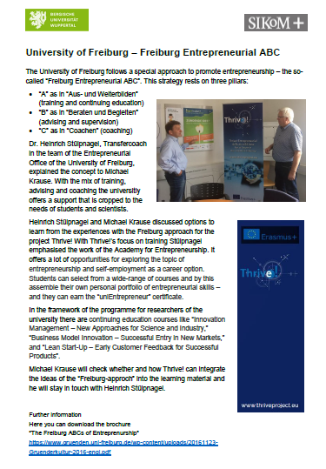
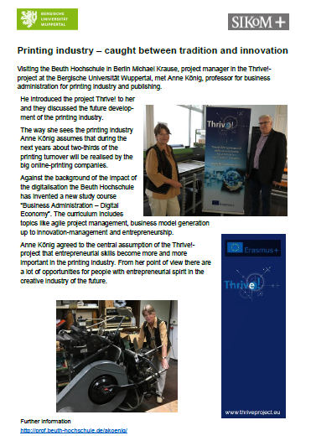
What we have done
Short project description on the website of the SIKoM with link on Thrive!-website
Presentation and discussion of the project with employees of SIKoM and BUW
Discussion, University of Freiburg
Presentation and discussion Beuth Hochschule, Prof. Anne König

Slide 3
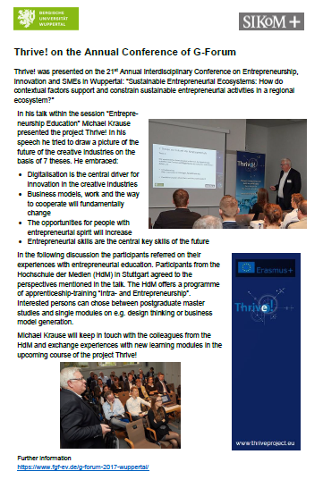
What we have done
Presentation on G-Forum „21st Annual Interdisciplinary Conference on Entrepreneurship, Innovation and SMEs” in Wuppertal, October 2017

Slide 4
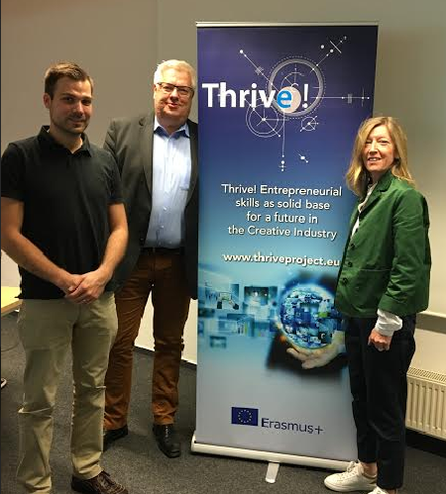
In progress
Presentation and discussion of the Thrive!-project with VDMNW – Verband Druck + Medien Nordwest e.V.
Points of discussion:
Workshop with consultants of VDMNW (Sep/Oct 2018)
Article on VDMNW-website and newsletter/mailing
Article in magazin NUTZEN
Workshop with print/media-companies (Nov/Dec 2018)
Development of a new offering/service for members of VDMNW academy / project
Presentation/workshop FDI – Fachverband der Druckindustrie und Informationsverarbeitung e.V.

Slide 5
In progress
Presentation and discussion at BVDM – Bundesverband Druck und Medien, Berlin Plan: end of june 2018
Points of discusison
Article on website, newsletter/mailing
Workshop with members
Talk on the annual congress
Presentation on G-Forum 2018 (10th -12th October 2018, Stuttgart) Guiding theme: „Mastering the Digital Transformation: Corporate Entrepreneurship as a Fast Track to Innovation” „Entrepreneurship in the creative industry – a new ecosystem evolves“ (working title)
Article in special edition of „Journal of Business Research”. Title „Digital or not – the future of entrepreneurship and innovation“

Slide 6
Plans for the coming periods
Initiative „Kultur und Kreativwirtschaft NRW“
Mailing
Presentation and discussion of the project and the report(s)
BVDW – Bundesverband Digitale Wirtschaft Presentation and discussion of the project and the project
Series of articles in magazine „Deutscher Drucker“ and further magazines
Short summaries for the 5 subsectors (4-/8-pager) – to be published in different magazines, newsletters, etc.
Workshop with HDM Stuttgart
Follow-up discussion and activites with Beuth Hochschule and University of Freiburg
…

Slide 7
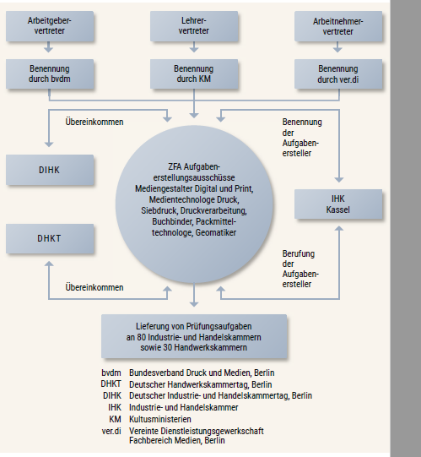
Plans for the coming periods
zfa – Zentral-Fachausschuss Berufsbildung Druck und Medien
all relevant actors in education and vocational training in Germany
Medien-Community https://www.mediencommunity.de/

