Slide 1
THRIVE!
Existing company profiles
Job profiles
Mike Hopkins
1/2 December 2016

Slide 2
Is there a typical company?
In reality there isn’t a “typical” company due to the diverse nature of the industry
So what are the important sectors (ie ones that will thrive in next 10 years and therefore likely recipients for training in entrepreneurship)
Some suggestions for debate:
  Print companies that offer integrated marketing solutions
  Digital marketing companies
  Packaging companies
  Point of sale/display companies
  Gaming
  Others?
The issue of company size? Will this emerge from the chosen sub sectors

Slide 3
Our research base
We are looking for the “Leaders”, not the “Laggards” or “Lost”
The successful businesses are those that have faced the challenges of the industry so we should identify those and extrapolate the characteristics from the challenges into a company profile and the job profiles will follow.
For the company challenges we are basing our thoughts on the work of Michael Porter (Harvard Business Review. From "How Competitive Forces Shape Strategy" by Michael E. Porter, March 1979) and his “five forces”

Slide 4
Michael Porter’s Five Forces
Existing competitive rivalry between suppliers
Threat of new market entrants.
Bargaining power of buyers.
Power of suppliers.
Threat of substitute products (including technology change)
We will first look at these in detail and then at the actions a business may take to address the challenges – these may be called the characteristics of an entrepreneur

Slide 5
Existing competitive rivalry between suppliers
Competition can be both good and destructive – it can result in a race for innovation and good customer service practices or a race to the bottom through price cutting
The successful business will characteristically seek the former route with on and offline innovation, collaboration and a marketing plan

Slide 6
  Threat of new market entrants.
As the price of technology falls and the power of processors increase new rivals with new ways to your customers’ markets will emerge
Government policy may indeed encourage such rivals – “the new digital economy”
Successful companies nurture relationships (customers, suppliers, educational) and are always early adopters and ahead of new entrants in investment in equipment and talent
Product and service differentiation will be key and successful companies will develop their own “brand” which will act as a “wall” to be scaled by new entrants
Networking at a senior level will be important

Slide 7
  Bargaining power of buyers.
The successful companies will NOT sell on price but on the trilogy of:
    Service (multi-level relationship)
    Innovation
    Value added (customer ROI)
The aim will be to eliminate buyer leverage by constant contact, understanding and service development

Slide 8
  Power of suppliers.
Similarly to working with buyers, relationships with suppliers will not be confrontational but mutually supportive
Building relationships is important for successful companies and will be done at all levels – operator through to CEO
The aim will be to deliver a price/service differentiation which will flow through to customers

Slide 9
  Threat of substitute products (including technology change)
This is perhaps the most challenging to companies and the successful ones will have multiple ears to the ground!
Market intelligence will emerge from relationships and networks at all levels in a company
The plan will to always be one step ahead of the buyer/customer and be ready to learn/innovate/collaborate

Slide 10
The actions
We will now look at the actions of a successful company (its profile?) in relation to the five forces
These may be termed the actions of an entrepreneur and lead to their attributes (though some are pure actions from which attributes will have to be extrapolated)

Slide 11
Existing competitive rivalry between suppliers
  Actions
    Customer database will have been analysed for current and future profitability – lose unprofitable customers
    Regular technology “sweeps” will be carried out with current and leading suppliers – what are HP/Canon doing?
    Customer service functions are highly valued in the company – not “lip service”
    There will be a thorough knowledge of leading competitors, their financial performance and strategy – and accountability for finding the information

Slide 12
Threat of new market entrants
Actions
    The company will have a “brand presence” in the marketplace – think of a well known printer?
    As above, regular contacts will be made with technology providers – go to open days!
    The company will be an enthusiastic networker (by attending exhibitions/conferences/informal events) by all levels especially at a senior level – eg DRUPA
    The company will the master of technology for the benefit of customers – not for the sake of a new Indigo
    The company will be a “talent hunter” and developer – university links

Slide 13
Bargaining power of buyers
Actions
    The company will have multi-level relationships with customers, not just a buyer
    The company will discuss innovation with the customer and demonstrate value by ROI statements – how many traditional print sales people can do this?

Slide 14
Power of suppliers
Actions
    Suppliers will be regarded as company departments (or at least partners) and treated as such – not the enemy
    Relationships will be strong at all levels

Slide 15
Threat of substitute products (including technology change)
Actions
    Links to the outside world will constantly scan the market and competitors and report regularly to the CEO – accountability?
    Similarly technology sweeps will be carried out through existing and potential suppliers
    Employees PDPs will contain an obligation to keep up to date with emerging technology (with a corresponding budget) – and supported by the company

Slide 16
In conclusion (and summary)
A typical “Leader” (“entrepreneur”) company will:
  Be well lead with short term objectives and a long term vision – what new markets are profitable DM, VDP?
  Be networked in the market and with technology providers
  Know the profitability and anticipate its customers needs by great customer service – what market are you in : same as my customer
  Be a talent rich and developer company

Slide 17
Some job profiles of today
The following are real job profiles
They show perhaps the difference between the traditional and the “new” sub sectors
We have extracted the attributes and not the duties/responsibilities

Slide 18
Packaging - traditional
Customer Services Executive | Packaging
Key attributes required:
Proven client management skills
Experience of working with corporate or blue chip organisations within a packaging environment is preferred
Strong communication skills both verbal and written
Ability to work in a lively environment which can at times be quite pressurised
Knowledge of packaging, specifically labels, is preferred

Slide 19
Sales manager/director – traditional

Slide 20
Sales Director - traditional

Slide 21
Digital Marketing Manager – print company

Slide 22
Operations Director – getting there!

Slide 23
Graphic Designer (junior) - better

Slide 24
Create awesome things
Creative Designer – modern approach

Slide 25
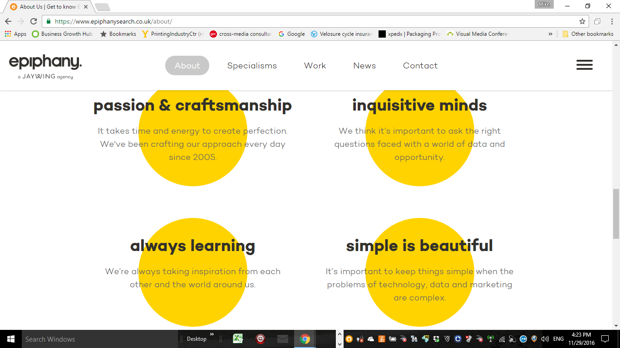
Just for fun…the DNA of a modern entrepreneurial business

Slide 26
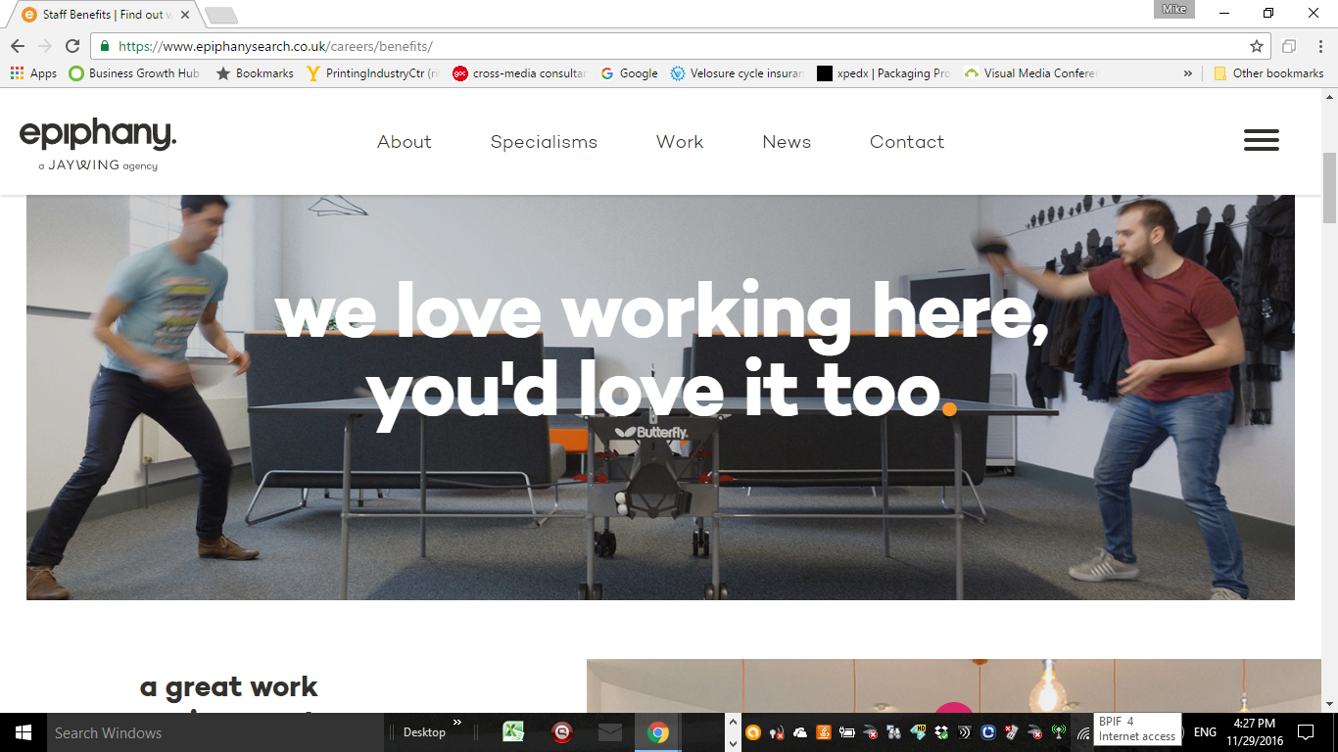
Same business

Slide 27
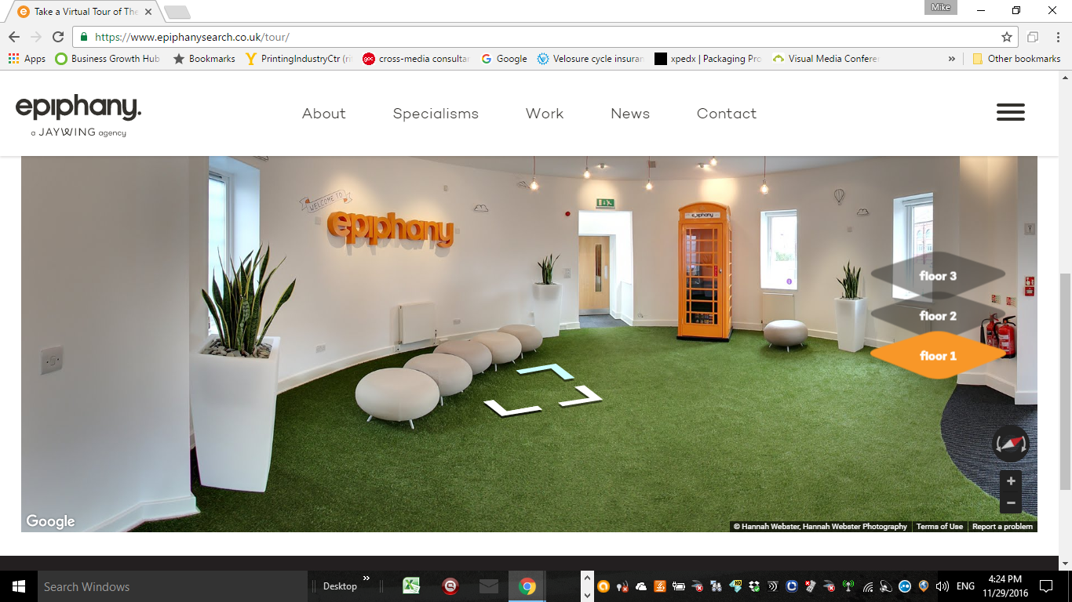
Their reception

Slide 28
And now some research on Entrepreneurial knowledge/skills
This is from the UK’s National Apprenticeship Service
  It is NVQ level 4
Entrecomp
Skills Panorama
Academic research

Slide 29
Apprenticeship Standard: Entrepreneur
OCCUPATION: Entrepreneur
(Social Entrepreneur or Commercial Entrepreneur)
B. OCCUPATIONAL PROFILE:
An entrepreneur is someone who spots an opportunity and starts a venture –
a product, service or process that aims to generate income and/or create value/ positive change while solving a problem, meeting a need or providing a benefit to a specific target group. This may involve using business solutions to tackle social or environmental issues.
As part of this role, the entrepreneur finds an innovative solution to an existing problem, identifies the resources needed to develop the solution, plans a series of strategic actions and collaborates with relevant stakeholders to develop and launch a sustainable venture.
The entrepreneur has the specialist knowledge and skills needed to start a venture, and will then delegate and/or engage with others where appropriate during its development to ensure it is fully established and successfully maintained
“An entrepreneur will not be constrained by the limitations of existing resources”

Slide 30
KNOWLEDGE An entrepreneur will understand:
Product/service development
How to identify, create/ refine an innovative product/service in response to the
needs of potential customers/beneficiaries. They will be aware of the competitive
landscape.
Business planning
The principles of setting up and planning a venture including the issues that can
affect its success or failure. How to identify the appropriate business model and
phases of development for the planned venture. How to identify the social
competitive advantage as well as balance the social goals of the venture with a
sustainable business model, where appropriate.
Develop collaborative relationships
How to develop relationships that are of value to start the venture (e.g. social
capital, support community)

Slide 31
KNOWLEDGE An entrepreneur will understand:
Target market segmentation
The needs of different groups of potential customers/beneficiaries and how they
are best served by the venture.
Decision-making
The principles and the basic tools of decision-making in starting a venture.
Financial management and funding
The principles of basic accounting (e.g. cash flow and pricing) and the different
options in raising start-up capital (e.g. investment, loans, family & friends)
Governance
The most appropriate legal structure for the venture they are setting up and its
related legal and statutory requirements and responsibilities.
Selling, marketing and branding
How to create a brand, marketing and sales plan and identify/develop appropriate
routes to market.

Slide 32
KNOWLEDGE An entrepreneur will understand:
Performance and impact evaluation
The importance of establishing goals. The appropriate tools/methods to collect, measure and evaluate the performance and the impact of the venture and report to external stakeholders.
Ethical principles, social responsibility and impact
How their own ethical principles and motivations affect decisions about how the venture is set up and launched including how they manage their own
well-being.
Technological awareness
The importance of technology to deliver impact and innovation for the venture.
Intellectual property
The importance of protecting their ideas, the implications of using others people’s ideas and the potential options for them to protect their idea.

Slide 33
SKILLS An entrepreneur is able to:
Problem-solving
Identify problems or opportunities by using techniques such as analytical and
creative thinking to create innovative and sustainable solutions. Recognise and
accept failure as a learning opportunity.
Managing risk
Identify and understand the impact of key risks when starting a venture and
develop a plan to address it (e.g. demand, revenue, market, liability, health
And safety).
Decision-making
Make informed decisions in a timely manner and understand the process involved
in arriving at those decisions.
Business planning and strategic thinking
Develop strategic and operational plans to deliver the objectives of the new
venture (e.g. testing assumptions, testing the market, identifying the demand, the
appropriate routes to market and revenue streams and planning accordingly).

Slide 34
SKILLS An entrepreneur is able to:
Manage tasks and resources
Plan, organise and manage resources in order to successfully develop and launch
the venture.
Selling, marketing and branding
Succinctly articulate the value of the venture and develop a marketing and/or
engagement plan in order to persuade others to support the new venture.
Financial literacy
Use financial data to plan and manage the operations of the venture.
Data management
Analyse and understand information to recognise assumptions, trends,
opportunities and challenges in the process of setting up a venture and respond
appropriately.

Slide 35
SKILLS An entrepreneur is able to:
Leadership and management
Evaluate their own strengths and limitations. Influence, motivate and bring
people around them to fill those gaps and support the venture.
Networking and relationship building
Communicate and collaborate effectively with a diverse range of stakeholders
necessary for the start of the venture

Slide 36


Slide 37
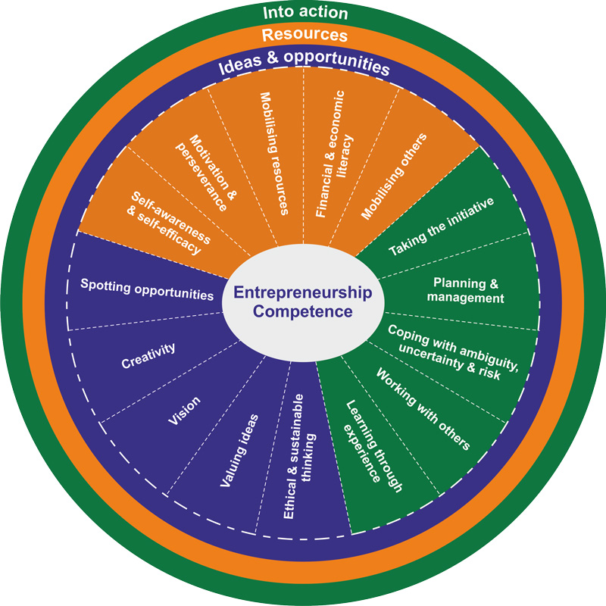

Slide 38
EntreComp was developed by the Joint Research Centre (JRC) of the European Commission on behalf of the Directorate General for Employment, Social Affairs and Inclusion (DG EMPL)

Slide 39
This report presents the EntreComp Framework. By producing a common definition of what entrepreneurship as a competence is, the framework aims to establish a bridge between the worlds of education and work and to be taken as a reference de facto by any initiative which aims to foster entrepreneurial learning

Slide 40
The EntreComp Framework is made up of 3 competence areas: ‘Ideas and opportunities’, ‘Resources’ and ‘Into action’.

Slide 41
The EntreComp study was launched by the JRC on behalf of DG Employment, Social Affairs and Inclusion, in January 2015. Its ambition is to build a bridge between the worlds of education and work, by contributing to a better understanding and promotion of entrepreneurship competence in Europe.

Slide 42
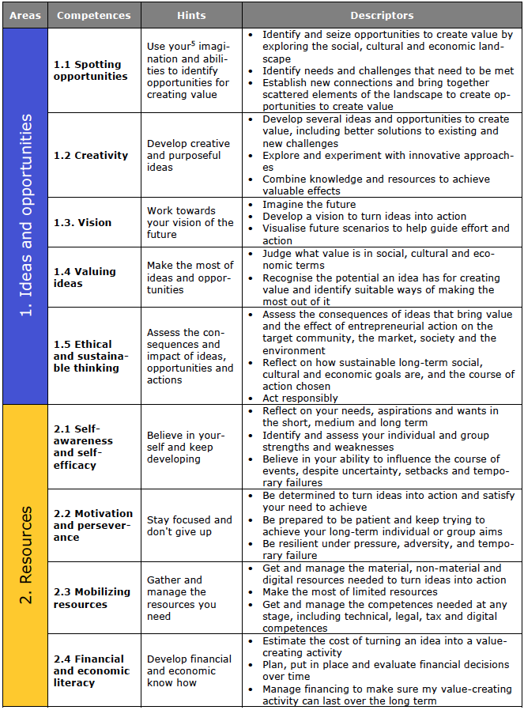

Slide 43
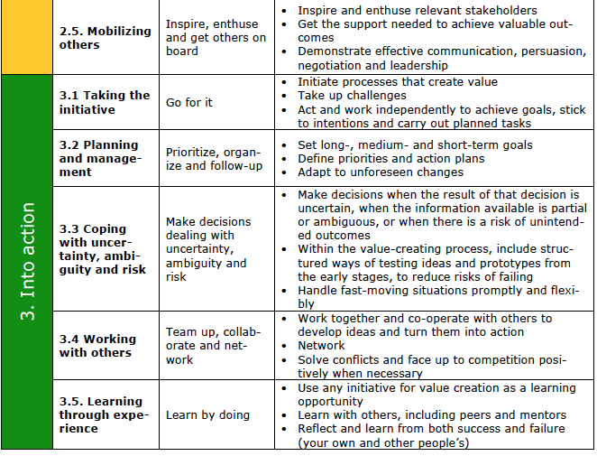

Slide 44
Skills Panorama
http://skillspanorama.cedefop.europa.eu/en/content/our-mission

Slide 45
Skills Panorama
Mission
The Skills Panorama turns labour market data into useful, accurate and timely intelligence that helps policy-makers in making their decisions on skills and job in Europe.

Slide 46
Skills Panorama
Why
Labour markets and skills needs are constantly evolving. Skills Panorama helps you keep up with the latest developments and make useful comparisons to previous trends or identify anticipated changes.

Slide 47
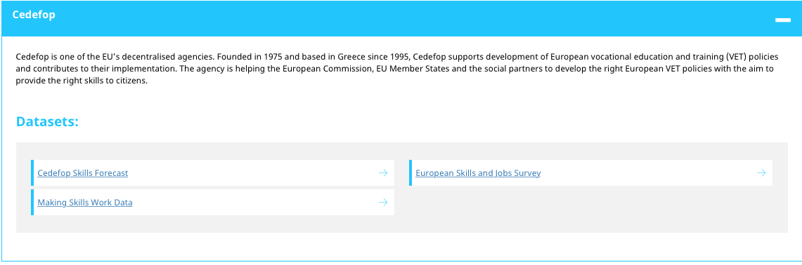
Skills Panorama
Sources

Slide 48
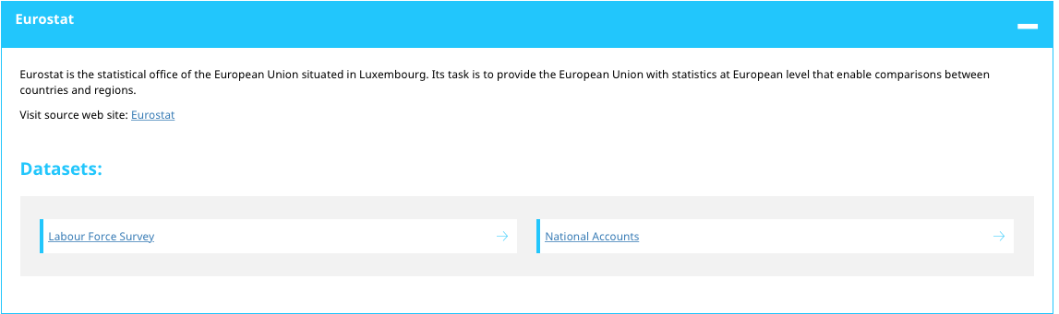
Skills Panorama
Sources

Slide 49
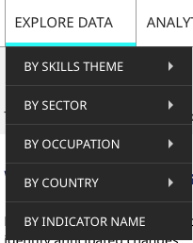
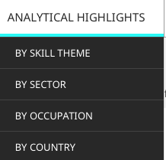
Skills Panorama
Possibilities

Slide 50
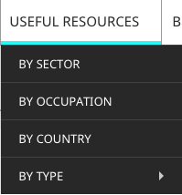

Skills Panorama
Possibilities

Slide 51

What makes Business, Entrepreneurship & Marketing BA (Hons) at Worcester special?
This is a highly distinctive course which broadens your career options and signals your areas of specialist expertise in marketing and entrepreneurship. You will develop skills (such as persuasive communication, the ability to think creatively and analytically, make logical decisions, innovate and manage projects) to underpin a successful career in business.
This course is ideal preparation whether you aspire to start up your own business, work in high-growth organisations or apply for a position in marketing or sales management. The course will capture employers’ attention and is taught by active entrepreneurs (including a feature on Dragon’s Den), start-up specialists and venture capitalists and by marketing specialists with extensive experience of domestic and international marketing. The course is mapped against the Chartered Institute of Marketing's Professional Marketing Standards

Slide 52
Core module
Entrepreneurship & Small Business Management
This module develops an understanding of the techniques and skills required to achieve success in the highly-competitive entrepreneurship and small-business-management sector. You will consider the role of entrepreneurial innovation in developing unique products and methods of service delivery. You will also learn key business planning skills; how managing in an SME environment is different to that of a large organisation; how to monetise a commercial idea; and how to create social value through the establishment of both commercial and social enterprises.
Sample assessment: Group business plan

Slide 53
Academic research
Entrepreneurship – Dr Robert Perrett (Bradford University Management School)
Core text book
Burns, P. (2011). Entrepreneurship and Small Business, 3rd edition. Basingstoke: Palgrave Macmillan. New edition (2016) is now available.
Other books on the basics
Rae, D. (2007). Entrepreneurship: From Opportunity to Action. Basingstoke: Palgrave Macmillan.
Timmons, J.A. and Spinelli, S. (2009). New Venture Creation – Entrepreneurship for the 21st Century, 8th edition, International edition. New York: McGraw-Hill, Irwin.
Bridge, S., O’Neil, K. and Martin, F. (2009). Understanding Enterprise, Entrepreneurship and Small Business. Basingstoke: Palgrave Macmillan.
‘Good start’ articles
Gartner, W.B. (1988) ‘“Who is an entrepreneur?” is the wrong question’, American Journal of Small Business, Spring 1988: 11-32.
Shaver, K. and Scott, L. (1991) 'Person, Process, Choice: the psychology of new venture creation', ETP, 16(2): 23-42.
Sarasvathy, S. (2001) 'Causation and Effectuation: towards a theoretical shift from economic inevitability to entrepreneurial contingency', AMR, 26(2): 243-88. (For an alternative perspective on entrepreneurial decision making and opportunity)

Slide 54
Academic research
Some core articles
Baumol, W. J. (2004) ‘Entepreneurial cultures and countercultures’, Academy of Management Learning and Education, 3: 316-26.
Low, M. and MacMillan (1998) ‘Entrepreneurship: past research and future challenges’, Journal of Management, 14(2): 2-26.
Shane, S. and Venkataranam, S. (2000) ‘The promise of entrepreneurship as a field of research’, Academy of Management Review, 25(1): 217-26.
Stevenson, H.H. and Carlos Jarillo, J. (1990). A Paradigm of Entrepreneurship: Entrepreneurial Management, Strategic Management Journal (1986–1998), 11(5), pp.17–17.
Some current debate article
Zahra, S.A., Wright, M. and Abdelgawad, S.G., (2014). Contextualization and the advancement of entrepreneurship research. International Small Business Journal.
Rehn, A., Brännback, M., Carsrud, A. and Lindahl, M., 2013. Challenging the myths of entrepreneurship?. Entrepreneurship & Regional Development, 25(7-8), pp.543-551.
I also have an introduction/applied perspective handbook, from a distance learning module

Slide 55
Questions?
Comments?
Where next?

Slide 56
Is there a conclusion?
There are many sources of “inspiration”
But there are great similarities
We have to synthesise the sources
And produce a definition of the key attributes of an entrepreneur in the “creative industries”

Slide 57
Decisions to be made
What are the “creative industries”?
What are the key attributes of an entrepreneur?
Are they universal in the creative industries?
If not are there sub sector nuances?
After these decisions are made we will develop the questionnaire for country research

