Slide 1
Company Profiles
Kick-Off-Meeting
Amstelveen, 1st Dec 2016
THRIVE

Slide 2
Concept matrix
Subsectors of creative industry
Types of Companies
Target groups
THRIVE

Slide 3
Subsectors of creative industry
THRIVE

Slide 4
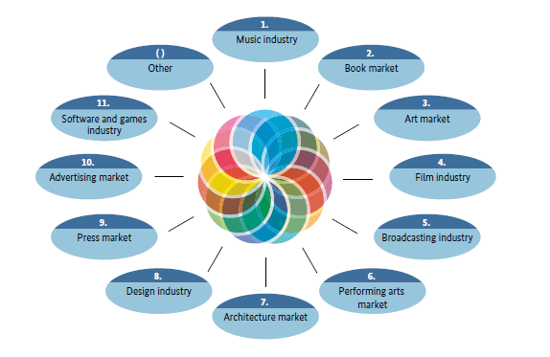
Culture and creative Industries – definition and subsectors
Definition
“The culture and creative industries
comprise all cultural and creative enterprises that are mainly market-oriented and deal with the creation, production and/or dissemination through the media of cultural/
creative goods and services. The main criterion for the definition is the commercial character of the company.”
(Conference of Economic Ministers )
THRIVE

Slide 5
Creative industry - subsectors
Number of companies: 13.834
Number of employees: 48.267
Turnover: 8.313
?
Number of companies: 36.452
Number of employees: 359.267
Turnover: 33.739
?
Number of companies: 16.967
Number of employees: 72.922
Turnover: 13.634
?
Number of companies: 29.930
Number of employees: 145.555
Turnover: 25.691
Number of companies: 12.966
Number of employees: 18.388
Turnover: 2.086
?
?
Number of companies: 18.453
Number of employees: 58.686
Turnover: 9.509
Number of companies: 31.912
Number of employees: 149.949
Turnover: 30.824
X
X
Number of companies: 18.309
Number of employees: 42.606
Turnover: 9.707
Number of companies: 57.469
Number of employees: 141.610
Turnover: 18.667
THRIVE

Slide 6
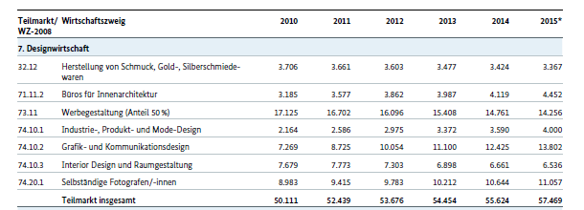
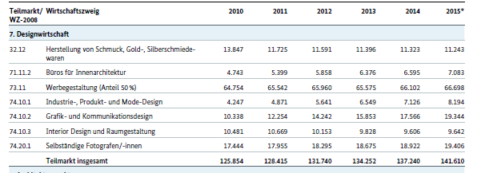
Design industry
THRIVE

Slide 7
Press Market
THRIVE

Slide 8
Advertising market
THRIVE

Slide 9
Software- and games-industry
THRIVE

Slide 10
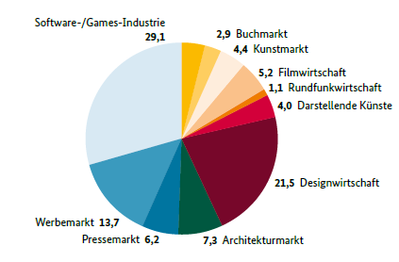
Foundations in creative industry
THRIVE

Slide 11
Subsectors
Subsectors
Software- and games-industry
Design industry
Advertising market
Press market
???
???
THRIVE

Slide 12
Types of companies
THRIVE

Slide 13
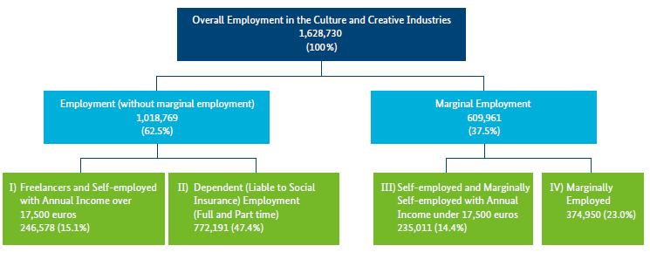
Structure of employment in the creative industry
THRIVE

Slide 14
Size of companies
creative industry
Start-ups
Percentage self-employed people
23 % (overall employment)
Percentage of small enterprises (< 2 Mio. €)
97 %
THRIVE

Slide 15
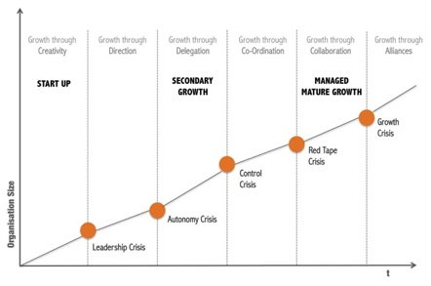
Lifecycle of Companies
THRIVE

Slide 16
Phases and characteristics / challenges
!
Selection of products and markets
Few employees
Informal structures of communication
Incentives
Profit sharing
Formal communi-cation structures
Formal responsibilities
Variety of products
-> complexity
Department heads
New products and markets
Top management: controlling/ monitoring
Formal governance
Increase of bureaucracy
Matrix organisation
Intelligent information systems
Growth by
Merger
Outsourcing
Networking
!
Most companies get stuck in this phase
Founder has to give off responsibility
Red tape crisis
New culture is needed
New structure is needed
Crisis of internal growth
Growth by partnerships
Control crisis
New definition tasks of top management
Improve cooperation of departments
Leadership crisis
Management needed
New role for founders
Autonomy crisis
New structures for delegation needed
New empployees?
THRIVE

Slide 17
Types of companies
 | Creativity | Direction | Delegation | Co-ordination | Collaboration | Alliances
< 10
< 20
< 50
< 100
???
THRIVE

Slide 18
Target groups
THRIVE

Slide 19
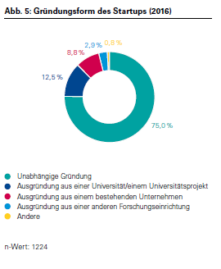
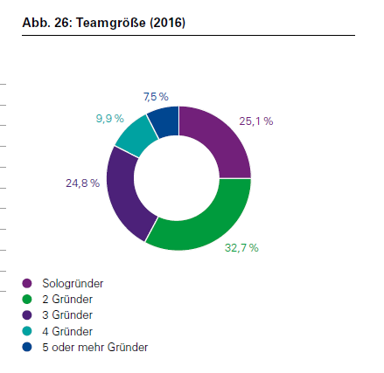
„Type“ of foundation
THRIVE

Slide 20
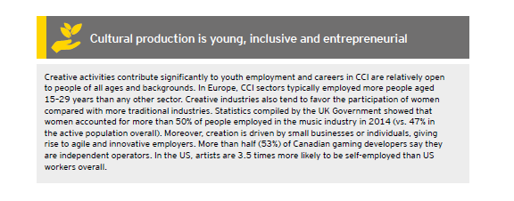
Age of entrepreneurs
THRIVE

Slide 21
Target groups
Support foundation of enterprises
Person
Single/solo entrepreneurs
Teams of entrepreneurs
female entrepreneurs
???
„Origin“ of entrepreneur
Student
University / research institute (employee)
Existing enterprise
„Strategic“ ???
???
Support enterprises in (different) crisis in their lifecycle
THRIVE

Slide 22
Target groups
 | Single / solo | Team | Female | ??? | ???
Student
Employee University
Existing enterprise (Person)
Strategic (Organisation)
THRIVE

Slide 23
Personas
 | Cristine | Martin | Harold and Maud | ??? | ???
Age | 23 | 41 | 26 and 27
Gender | female | male | male/female
Qualification/ Know-how | Software-engineer | Advertising merchant
Current status/career | student | employee | Scientists in research institute
Motivation | No alternative | Staff cuts | Invention | Crisis
Subsector | Design | Advertising | Games industry
Product(s)/ Service(s) (idea)
???
THRIVE

Slide 24
Concept for defining company profiles and target groups
THRIVE

Slide 25
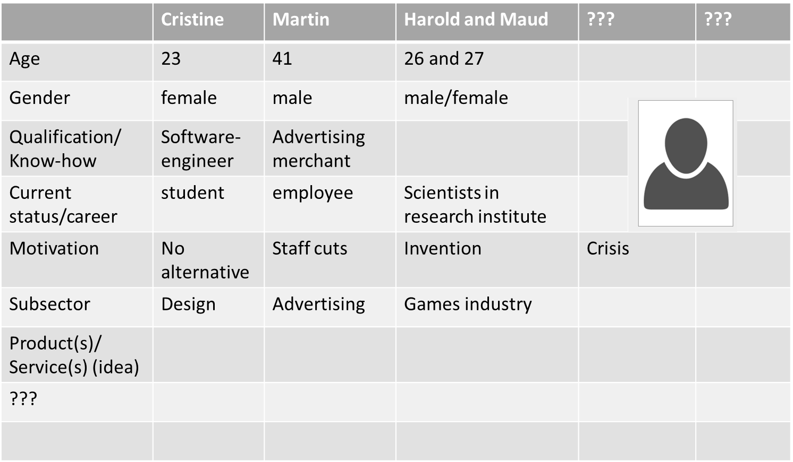
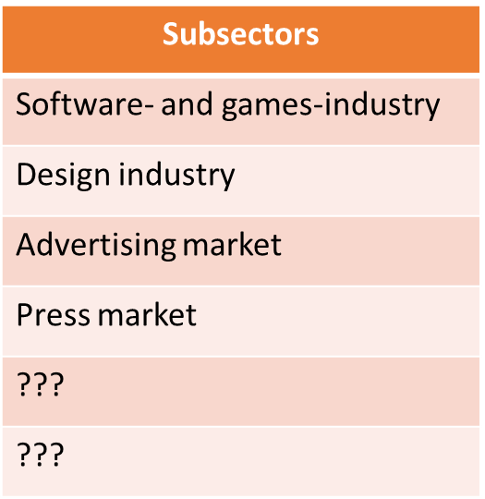
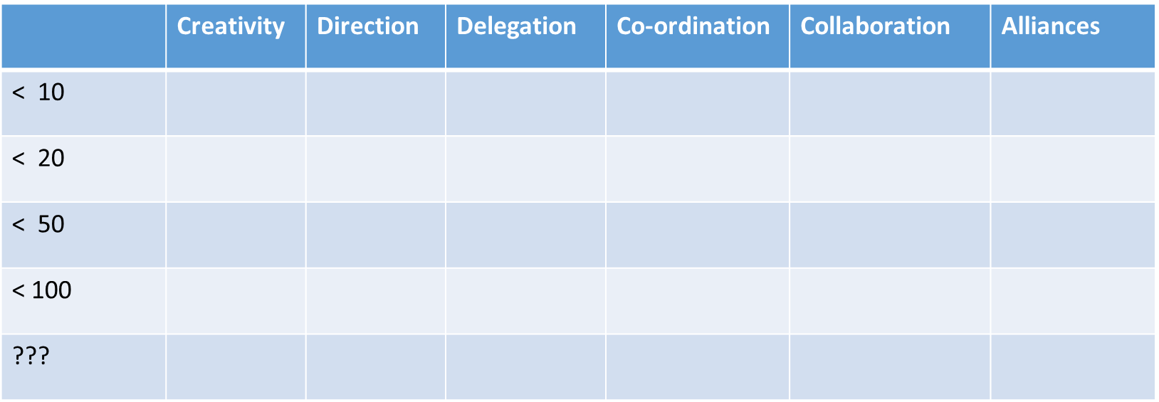
Concept
THRIVE

